Slide 1

Probability of Entering your Dream Graduation Program
Sean Xu
DATA1030 Fall22 S01
Hands-on Data Science
Dec 6th 2022
https://github.com/seanxxy0528/Data-project.git

Slide 2

Introduction
Problem:
What are factors deciding whether you are admitted to your dream program?
Importance:
What can you do to improve the probability?
Notes:
People always say that College admission is magic; Someone might be admitted with low tofel scores and gre scores, while others can not. Because these opinions just come with common sense or experience, I want to have a logical prediction of whether one can enter your dream program, what is the possibility of it, and what you can do to improve your possibility to admission. It is meaningful because if it predicts well, it is more reliable than some admission consulting companies that told parents the probability of admission for their child only based on experience.

Slide 3
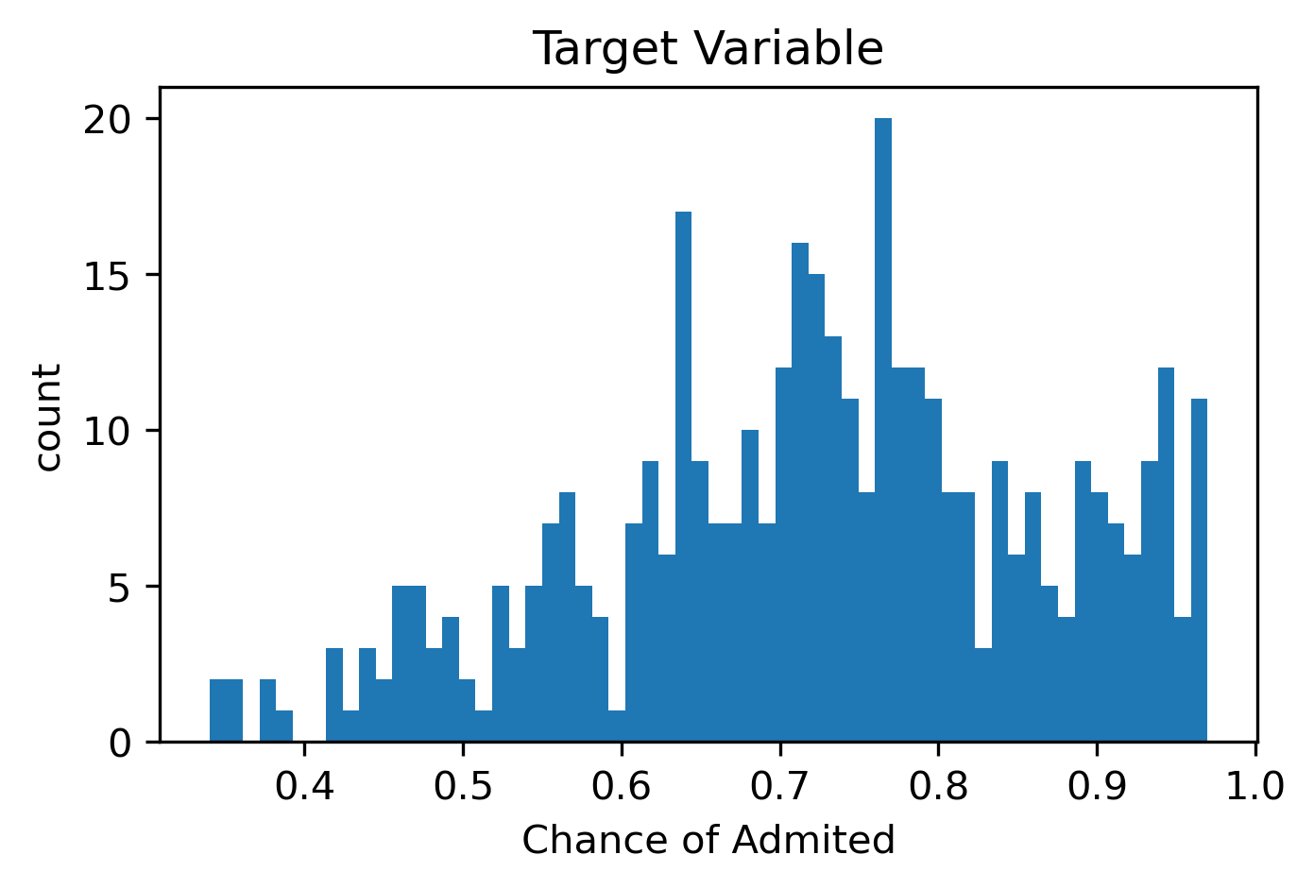
Recaps
Target variables: Chance of Admitted
Regression: Probability (0% - 100%)
400 rows x 8 columns
7 features 1 target variables
Kaggle: UCLA Database
Notes:
I will first talk briefly of the introduction and some EDAs

Slide 4
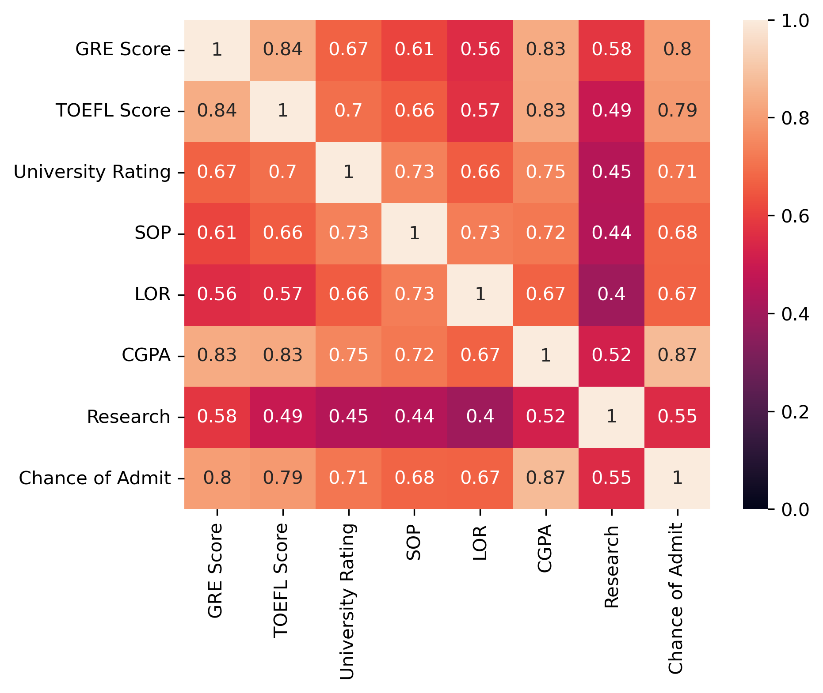
Recaps
Not so surprising
V.S. target variables
Highest three:
GPA (0.87) GRE (0.8) TOFEL (0.79)
Hard skills
GPA and GRE and Tofel are all over 0.8
But what surprised me was
University ranking with SOP and GRE
Notes:
First, I want to use the heatmap to show a broad correlation of the Chance of Admission to all other features
More close to 1, the more relative they are
Not surprisingly, GRE, Tofel, and GPA are three figures that has the highest correlation to target variable(chance of admission), around 8
And hard skills are correlated with each other which make sense Because there are people good at study
But what surprised me was the correlation of university ranking with others. As normal, we will think that the higher the school rank is, the higher are score should be, and the Statement of Purpose should focus more on individual rather than school ranking, but the result is the opposite. The school of ranking is more correlated to SOP rather than gre.

Slide 5
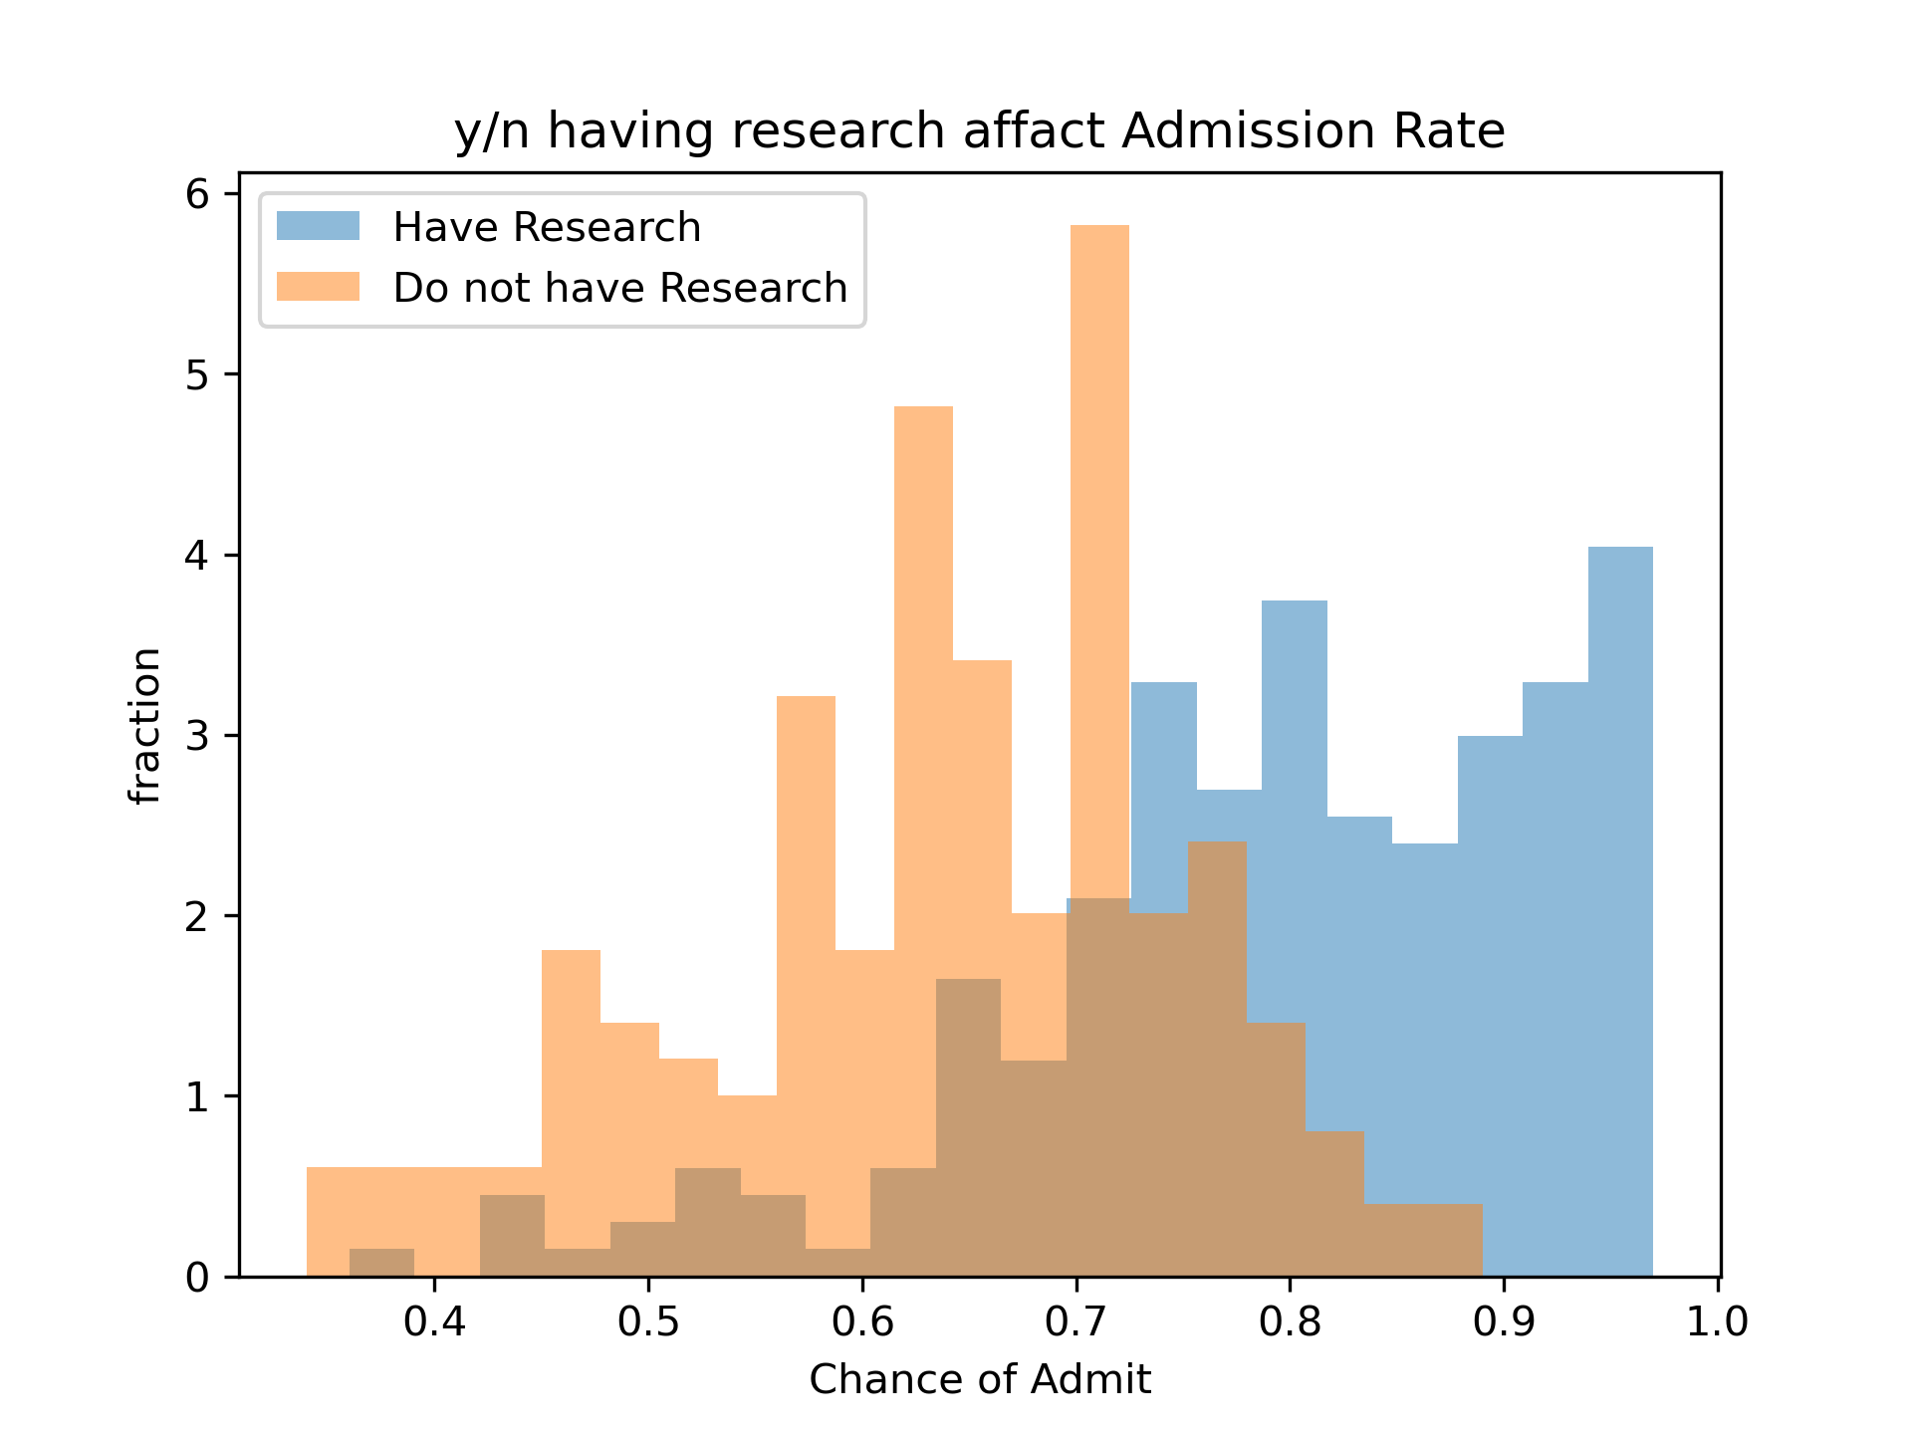
Recaps Search vs Admission
Most of the people do not have research has less than 75% chance of admit
If you want chance of admit > 90% need research
Notes:
While most of people have research have 70% chance of admit

Slide 6

CV Pipelines
No missing value
Simple Split, 5 random state
Use MinMax Scaler to continuous variables (GRE, TOFEL, and GPA)
Use Onehot Encoder to categorized variables
Notes:
Because the dataset is well-organized, there is not much I should do to deal with preprocessing
The categorized and ordinary variables are all in well form; what I have to do is to standardize GRE, TOFEL and GPA scores using minmax scaler because
They are continuous and in a range
They transform into 0-1 scale

Slide 7
CV Pipelines & Cross Validation
Model Name | Parameters Tuned
Linear Regression | None
Linear Regression with Lasso Regularization | Alpha = np.logspace(-3,3,10)
Linear Regression with Ridge Regularization | Alpha = np.logspace(-3,3,10)
KNeighborsRegressor | n_neighbors = [1, 3, 10, 30]
XGBoost | max_depth: [1, 3, 10, 20, 30]
RandomForest | min_samples_split = 5
6 Regression models
Record the best score for each models in each random state
Loop throughout 5 random State to find mean
Use RMSE

Slide 8
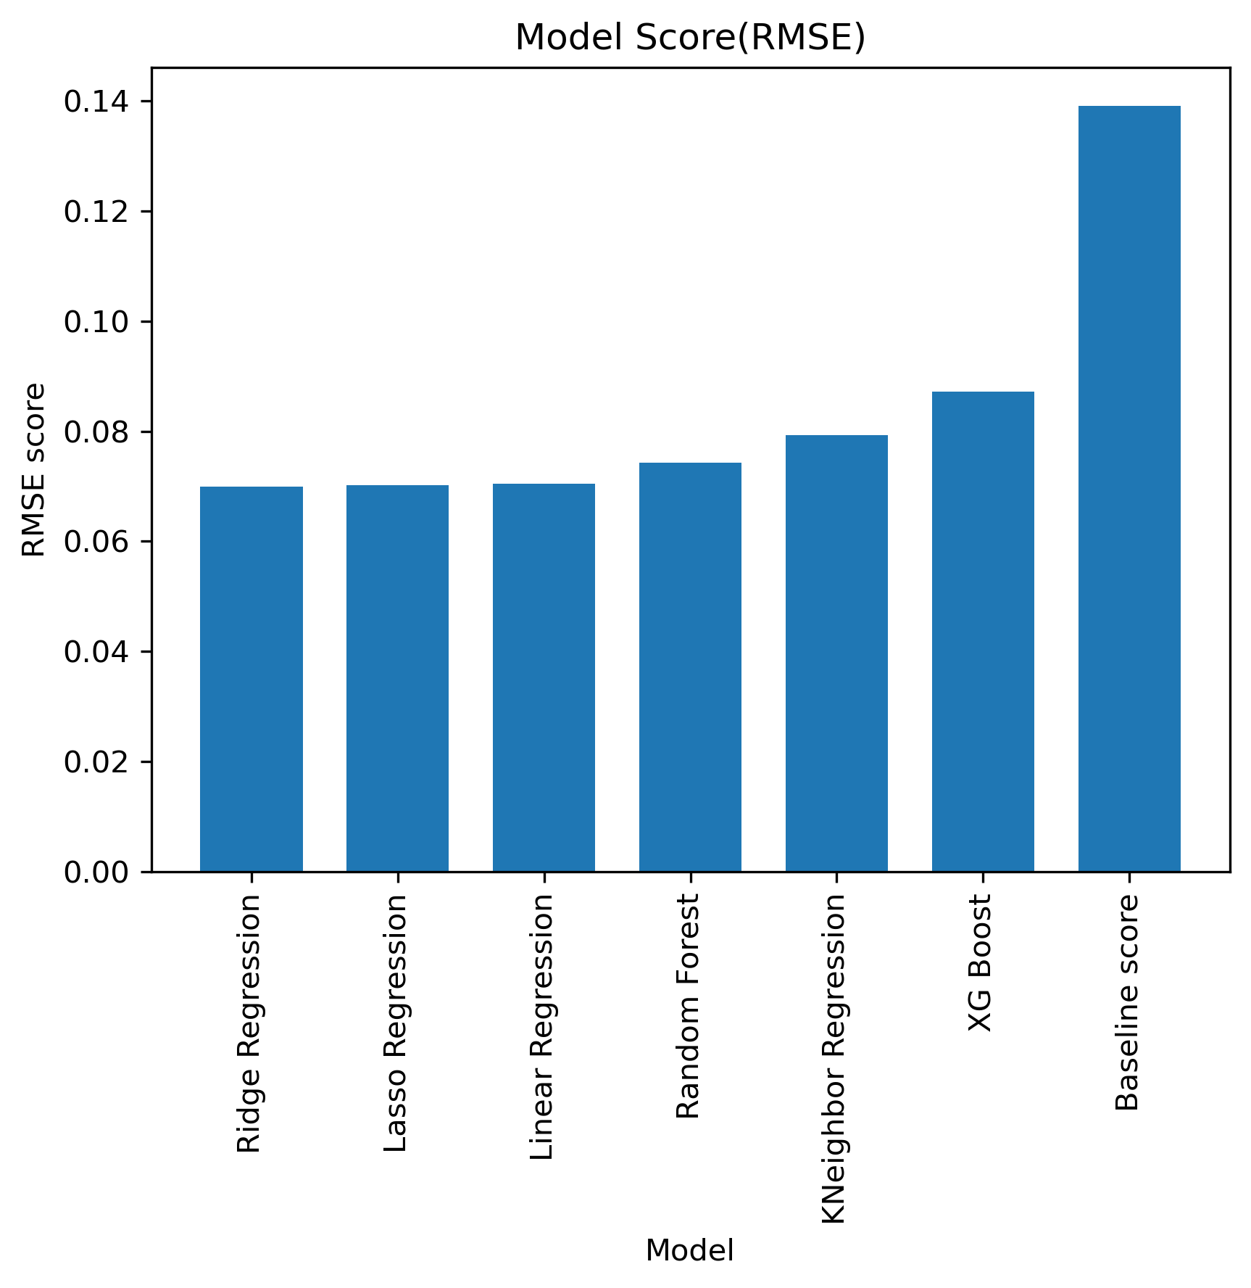
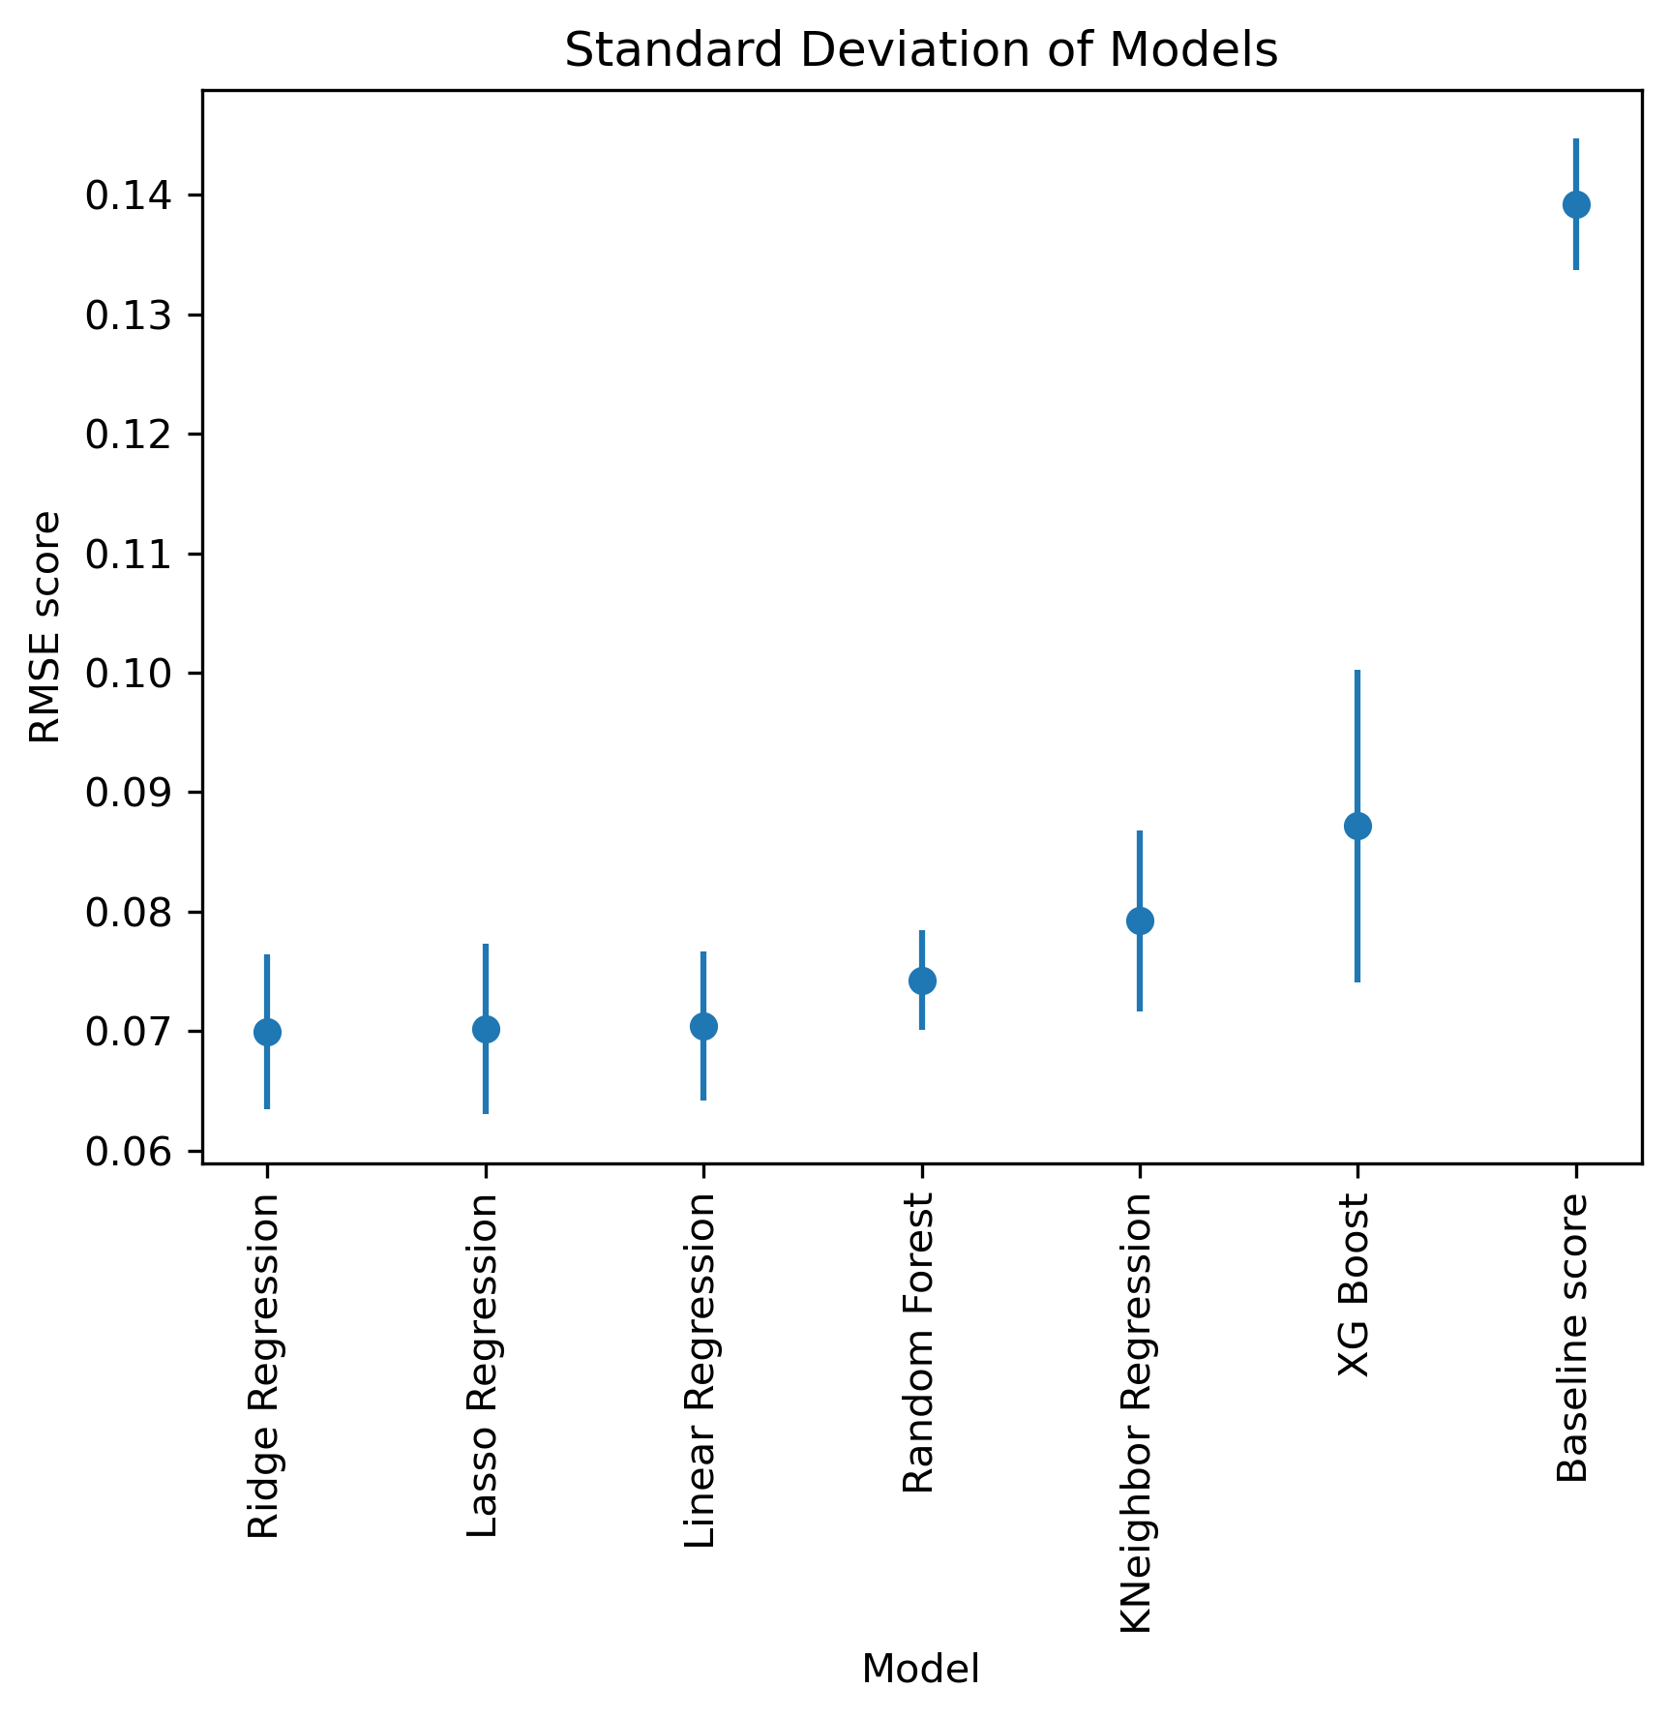
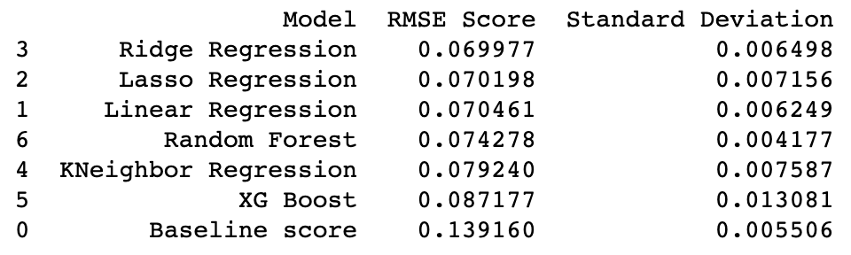
Result (Test Score)

Slide 9
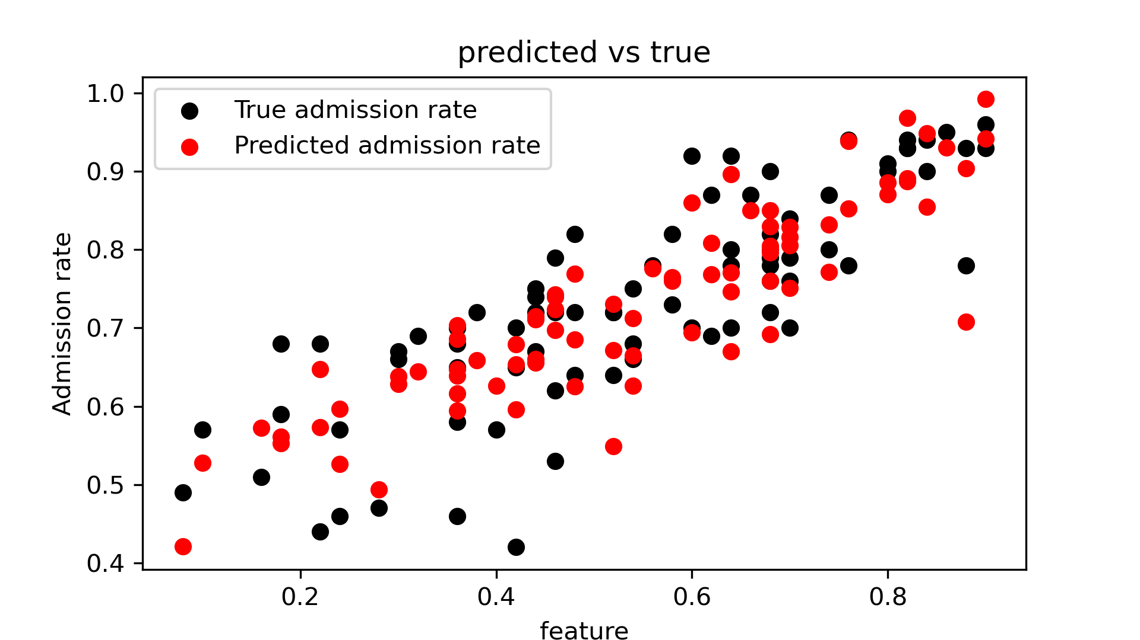
Result (Model inspection)
Predicted Chance of Admission is not so far from the data points
Generally in a line

Slide 10
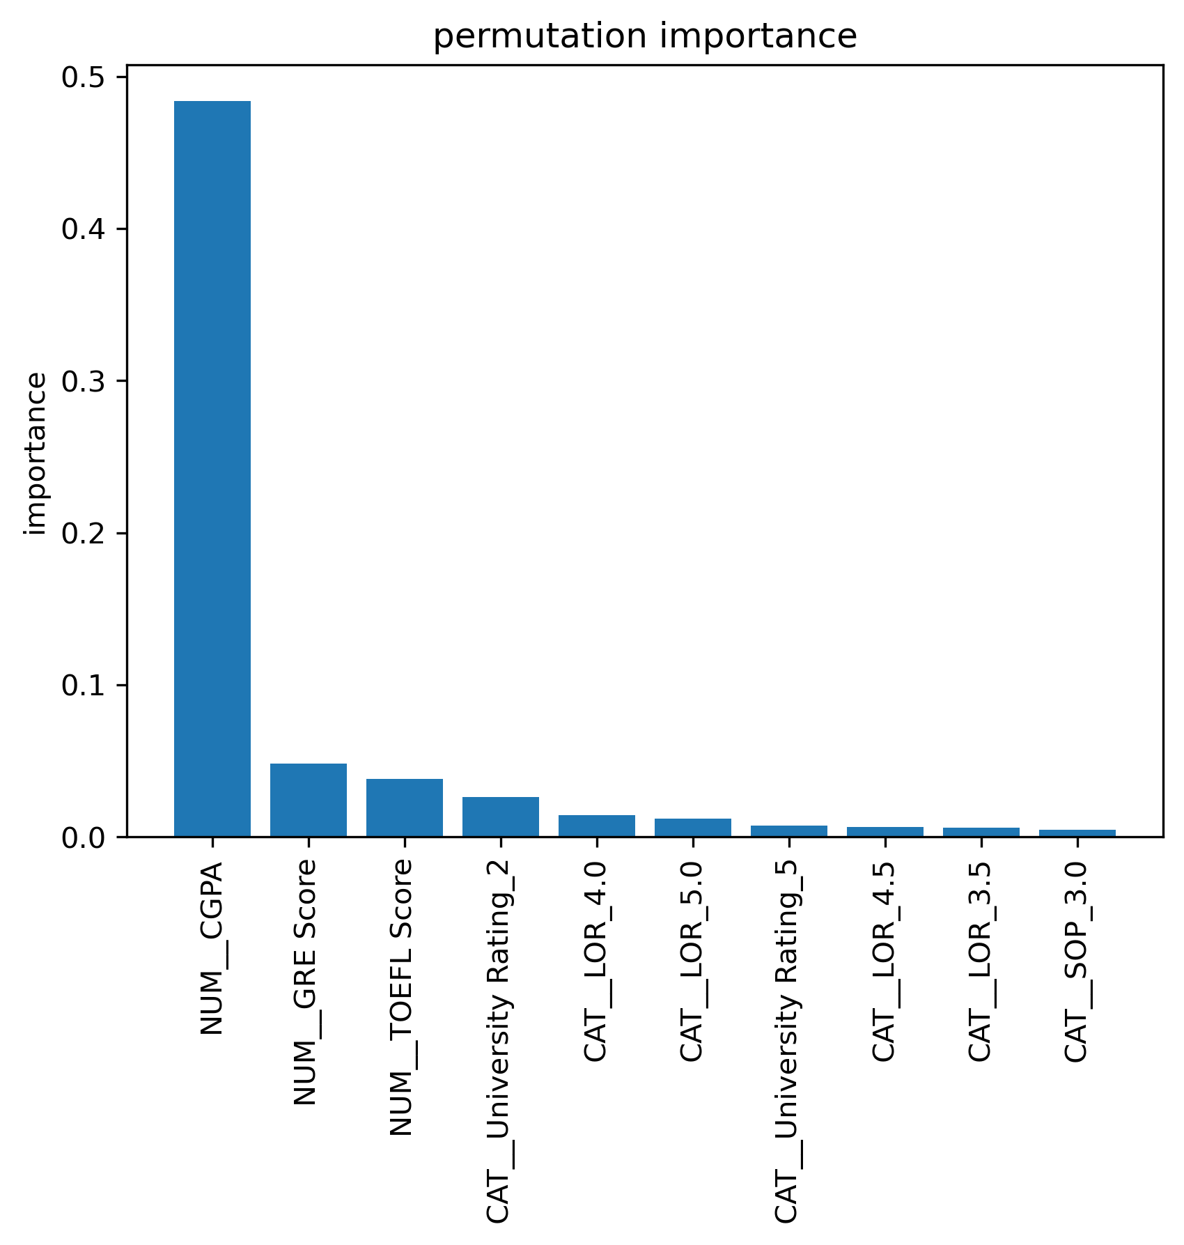
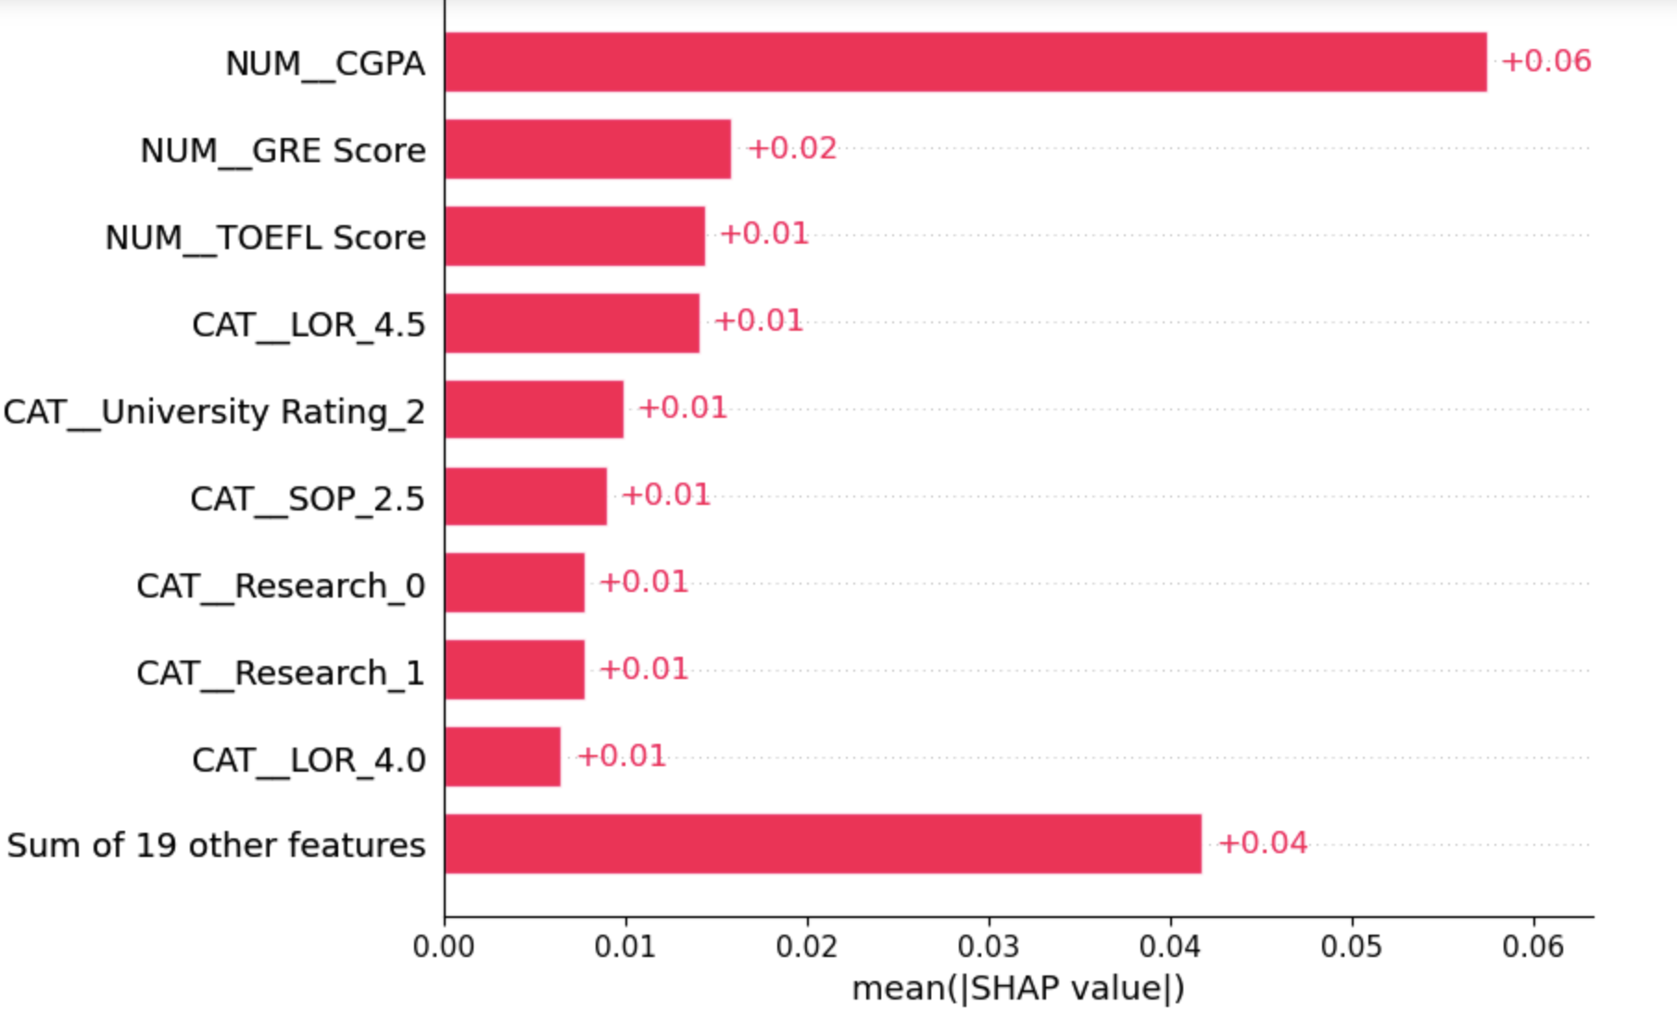
Result (Feature importance)

Slide 11

My Prediction
A student after hard work:
improve 5 in GRE, 3 in TOFEL, and 0.5 in CGPA can improve huge in admission rate
Student Profile:
NO. | GRE | TOFEL | University Rating | SOP | LOR | CGPA | Research Paper
1 | 323 | 102 | 3 | 5 | 4 | 9.0 | Yes
2 | 328 | 105 | 3 | 5 | 4 | 9.6 | Yes
Predicted Admission Rate1 = 78.14%
Predicted Admission Rate2 = 85.35%

Slide 12

Outlook
Try other models like LGBM
The size of data is not so big
Try to decrease std
Tune number more

